Slide 1
Files & Compression
”Can you send me a zip file?”

Slide 3
Memory or Storage
Memory
Represented by Mailboxes in LMC
Active
Non-Persistent
Open Files are generally stored here
Storage
Was not represented in LMC ☹
Semi-active
Persistent
Saved Files are generally stored here
The nice divide between these two has been blurred by portable devices.

Slide 4
Kilobytes
Kilo = 1000 but because computers count in powers of 2 (or binary) a kilobyte is actually 1,024 bytes
Mega = 1000000 but because computers count in powers of 2 a megabyte is 1024 kilobytes
This holds for giga, tera and peta as well
Giga = 1024 megabytes
Tera = 1024 gigabytes
Peta = 1024 terabytes

Slide 5
Compression
Compression refers to reducing the number of bits required to store or represent an object digitally
It is more commonly used to refer to making images, music, movies and text files smaller, but compression can apply to any digital document
As storage capacity has increased, the need for compression has somewhat reduced, but compression was absolutely essential to the digital revolution

Slide 6
Photograph => Digital Photograph
When you scan a document, the document is converted into an image through a process called scanning (or sampling)
We look at the document at discrete points throughout the document and capture the color at that point
If detail is lost when scanning, that means our discrete points were not close enough together so we undersampled

Slide 7
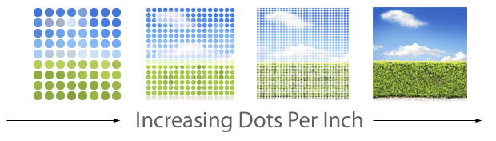
Dots Per Inch

Slide 8
Quality / Size
Higher resolution scans are used to prevent under sampling
200 – 600 dpi is a common range for sampling
Couldn’t we just permanently set our scanners at the highest dpi and call it a day
Higher Resolution = Bigger Files
In addition to not oversampling, we keep our files smaller by “compressing” them

Slide 9

Compression Example
This image is 1024 x 762
We need 3 bytes per pixel
Red, Blue, Green!
1024 x 768 x 3 = 2359296
2359296 / 1024 = 2304 KB
2304 / 1024 = 2.25 MB
But the file is only 548 KB???

Slide 10
Two Camps
Lossless Compression: no details are lost during the compression of the file
Lossy Compression: some details that probably wont be missed are thrown away

Slide 11
Lossless Compression Examples
PNG images
Web pages
Zip files
Word documents
…

Slide 12
Compression of Images
What are some ways we could compress images?
What if instead of each pixel having a color, we did groups of pixels and assigned a color to that group (called “spatial coherence”)

Slide 13
Compression of Videos
So how about videos?
What if we said that a group of pixels (say in the background) don’t change over this set of frames (known as ”temporal coherence”)
For example, if a character never walks in front of the left half of the screen for a scene, all of the details in the left half aren’t going to change, maybe…
The calculations for this have to be quick because videos typically run at 24 – 30 frames / second

Slide 14
Huffman Codes
We can also take something that is common throughout a file and assign it a code.
The more common it is, the shorter the code….

Slide 15
Lossy Compression
Consider the English language
What if we did like Hebrew and just threw all the vowels out?
Wld r sntncs b ndrstndble?
Maybe…, but some wouldn’t be
I fd fd t my gs

Slide 16

In Images… (See the Difference?)

Slide 17

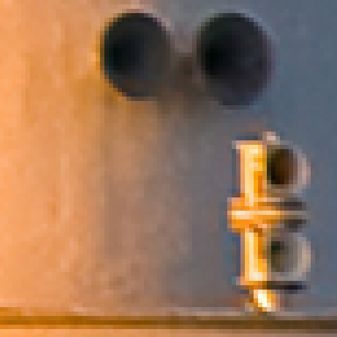
In Images… (How About Now?)

Slide 18
GIFs
In PNGs, we have 256 x 256 x 256 colors (or 16777216 colors)
In GIFs, we only have 256 colors
JPGs use an even trickier method
Colors that are similar (similarity can be selected by user) are converted to the same color since an untrained eye can’t see the difference
Then the same method used by PNG files is applied after the colors have been morphed

Slide 19
Music
MP3 files cheat too…
The higher frequencies, the ones easier to hear, are recorded so that they are split between the left and right ear (or stereo)
The lower frequencies, the ones harder to hear, are recorded in mono so that the both ears hear the same

Slide 20
Summary
Compression is what made the digital revolution possible, but compression doesn’t always mean perfect reduction
We do occasionally lose information in the process

